Slide 2
Lesson 7 Contents
Example 1 Verify Inverse Matrices
Example 2 Find the Inverse of a Matrix
Example 3 Use Inverses to Solve a Problem

Slide 3
Example 7-1a
Determine whether X and Y are inverses.
Check to see if X • Y = I.
Write an equation.
Matrix multiplication

Slide 4
Example 7-1b
Now find Y • X.
Write an equation.
Matrix multiplication
Answer: Since X • Y = Y • X = I, X and Y are inverses.

Slide 5
Example 7-1c
Determine whether P and Q are inverses.
Check to see if P • Q = I.
Write an equation.
Matrix multiplication
Answer: Since P • Q ≠ I, they are not inverses.

Slide 6
Example 7-1d
Determine whether each pair of matrices are inverses.
a.
b.
Answer: no
Answer: yes

Slide 7
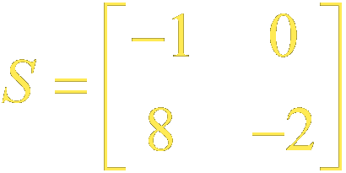
Example 7-2a
Find the inverse of the matrix, if it exists.
Find the value of the determinant.
Since the determinant is not equal to 0, S ^{–1} exists.

Slide 8
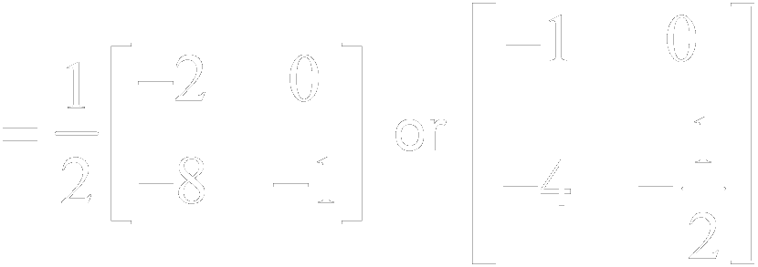
Example 7-2b
Definition of inverse
a = –1, b = 0, c = 8, d = –2
Answer:
Simplify.

Slide 9
Example 7-2c
Check:

Slide 10
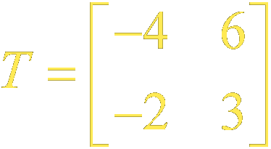
Example 7-2d
Find the inverse of the matrix, if it exists.
Find the value of the determinant.
Answer: Since the determinant equals 0, T ^{–1} does not exist.

Slide 11
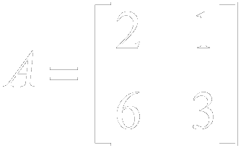
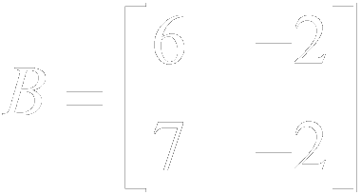
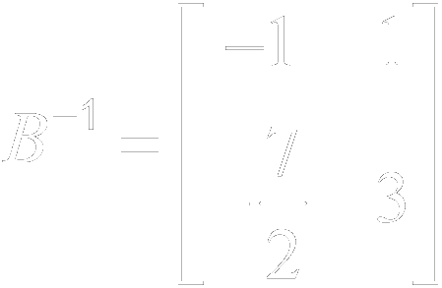
Example 7-2e
Find the inverse of each matrix, if it exists.
a. b.
Answer: No inverse exists.
Answer:

Slide 12
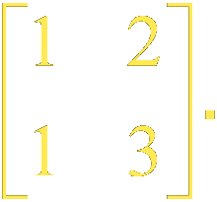
Example 7-3a
Use the table to assign a number to each letter in the message ALWAYS_SMILE. Then code the message with
the matrix
Code
_ 0 | I 9 | R 18
A 1 | J 10 | S 19
B 2 | K 11 | T 20
C 3 | L 12 | U 21
D 4 | M 13 | V 22
E 5 | N 14 | W 23
F 6 | O 15 | X 24
G 7 | P 16 | Y 25
H 8 | Q 17 | Z 26
Convert the message to numbers using the table.
A | L | W | A | Y | S | _ | S | M | I | L | E
1 | 12 | 23 | 1 | 25 | 19 | 0 | 19 | 13 | 9 | 12 | 5

Slide 13
Example 7-3b
Write the message in matrix form. Then multiply the message matrix B by the coding matrix A.
Write an equation.

Slide 14
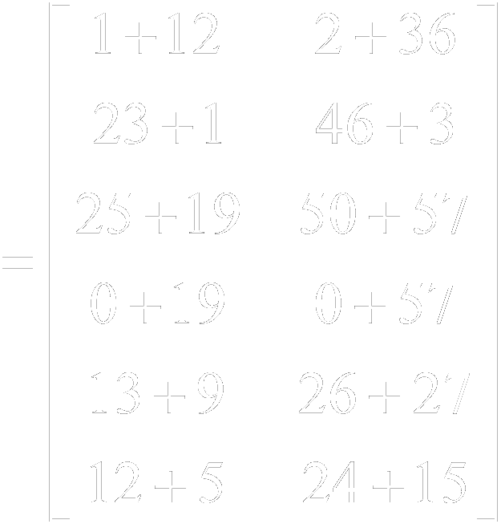
Example 7-3c
Matrix multiplication

Slide 15
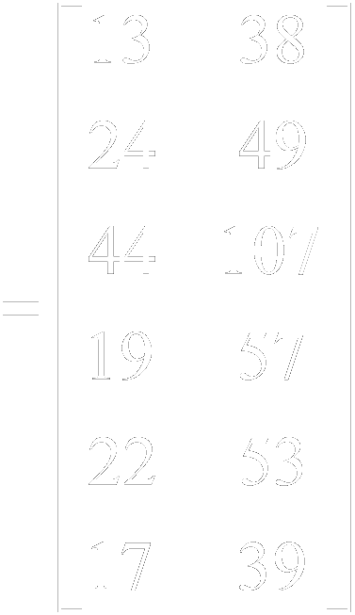
Example 7-3d
Simplify.
Answer: The coded message is 13 | 38 | 24 | 49 | 44 | 107 | 19 | 57 | 22 | 53 | 17 | 39.

Slide 16
Example 7-3e
Use the inverse matrix A^{–1} to decode 13 | 38 | 24 | 49 | 44 | 107 |19 | 57 | 22 | 53 | 17 | 39.
Definition of inverse
a = 1, b = 2, c = 1, d = 3
Simplify.

Slide 17
Example 7-3f
Next, decode the message by multiplying the coded matrix C by A^{–1}.

Slide 18
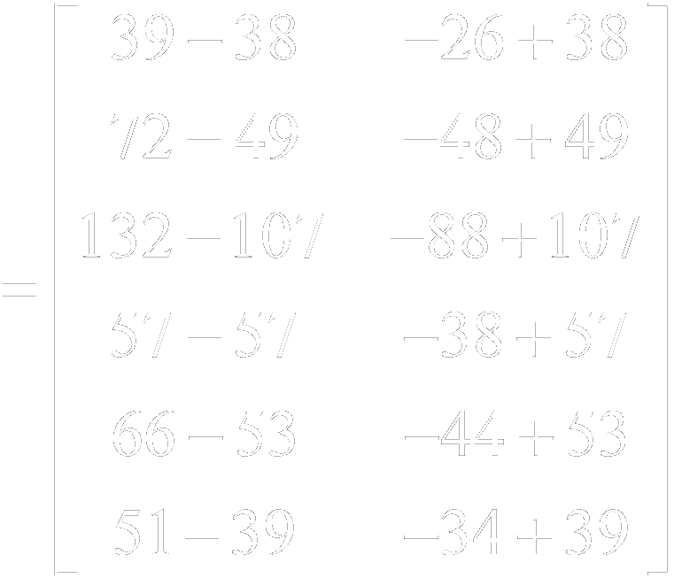
Example 7-3g

Slide 19
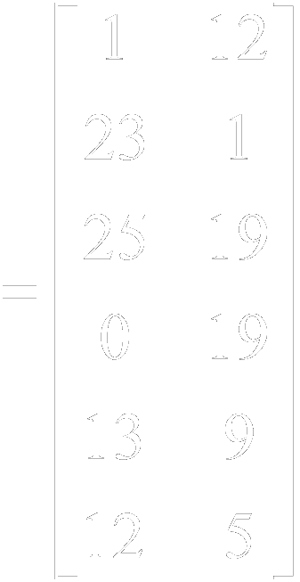
Example 7-3h

Slide 20
Example 7-3i
Code
_ 0 | I 9 | R 18
A 1 | J 10 | S 19
B 2 | K 11 | T 20
C 3 | L 12 | U 21
D 4 | M 13 | V 22
E 5 | N 14 | W 23
F 6 | O 15 | X 24
G 7 | P 16 | Y 25
H 8 | Q 17 | Z 26
Use the table again to convert the numbers to letters. You can now read the message.
Answer:
1 | 12 | 23 | 1 | 25 | 19 | 0 | 19 | 13 | 9 | 12 | 5
A | L | W | A | Y | S | _ | S | M | I | L | E

Slide 21
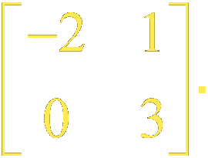
Example 7-3j
a. Use the table to assign a number to each letter in the message FUN_MATH. Then code the message
with the matrix A =
Code
_ 0 | I 9 | R 18
A 1 | J 10 | S 19
B 2 | K 11 | T 20
C 3 | L 12 | U 21
D 4 | M 13 | V 22
E 5 | N 14 | W 23
F 6 | O 15 | X 24
G 7 | P 16 | Y 25
H 8 | Q 17 | Z 26
Answer: 12 | 63 | 28 | 14 | 26 | 16 | 40 | 44

Slide 22
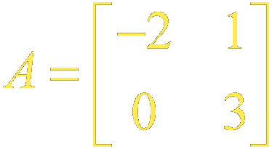
Example 7-3k
b. Use the inverse matrix of
to decode
the message 12 | 63 | 28 | 14 | 26 | 16 | 40 | 44.
Code
_ 0 | I 9 | R 18
A 1 | J 10 | S 19
B 2 | K 11 | T 20
C 3 | L 12 | U 21
D 4 | M 13 | V 22
E 5 | N 14 | W 23
F 6 | O 15 | X 24
G 7 | P 16 | Y 25
H 8 | Q 17 | Z 26
Answer:
6 | 21 | 14 | 0 | 13 | 1 | 20 | 8
F | U | N | _ | M | A | T | H

Slide 23
End of Lesson 7

Slide 24
Lesson 8 Contents
Example 1 Two-Variable Matrix Equation
Example 2 Solve a Problem Using a Matrix Equation
Example 3 Solve a System of Equations
Example 4 System of Equations with No Solution

Slide 25
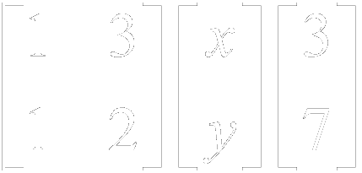
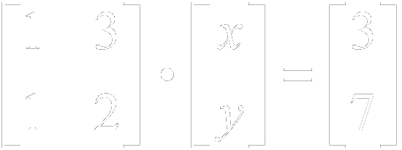
Example 8-1a
Write a matrix equation for the system of equations.
Determine the coefficient, variable, and constant matrices.
Write the matrix equation.
A
•
X
=
B
Answer:

Slide 26
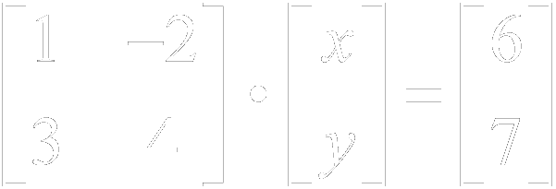
Example 8-1b
Write a matrix equation for the system of equations.
Answer:

Slide 27
Example 8-2a
Fabrics The table below shows the composition of three types of fabrics and cost per yard of each type.
Type | Wool | Silk | Cotton | Cost
R | 10% | 20% | 70% | $7
S | 20% | 30% | 50% | $8
T | 20% | 50% | 30% | $10
Write a system of equations that represents the total cost for each of the three fabric components.
Let w represent the percent of wool.
Let s represent the percent of silk.
Let c represent the percent of cotton.

Slide 28
Example 8-2b
Write an equation for the cost of each type of fabric.
Answer: Type R:
Type S:
Type T:

Slide 29
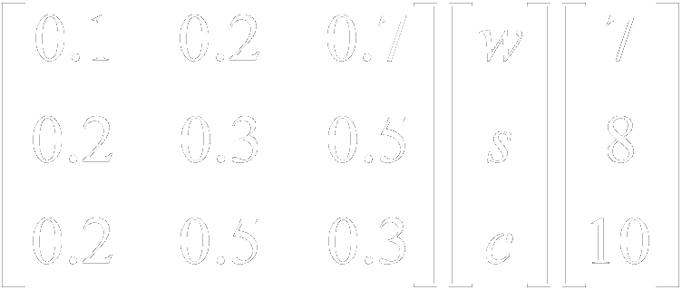
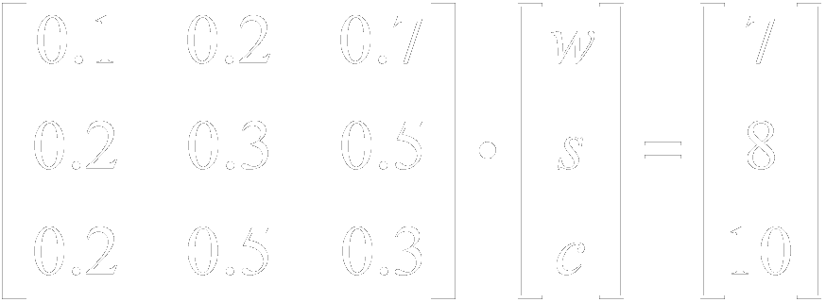
Example 8-2c
Write a matrix equation for the system of equations.
Determine the coefficient, variable, and constant matrices.
Write the matrix equation.
A
•
X
=
B
Answer:

Slide 30
Example 8-2d
Snacks The table below shows the composition of two types of snack mixes and the cost per pound of each type.
Mix | Nuts | Candy | Cost Per Pound
A | 50% | 50% | $4
B | 75% | 25% | $5
a. Write a system of equations that represents the cost per pound for each of the two snack mix components.
Answer:

Slide 31
Example 8-2e
b. Write a matrix equation for the system of equations.
Answer:

Slide 32
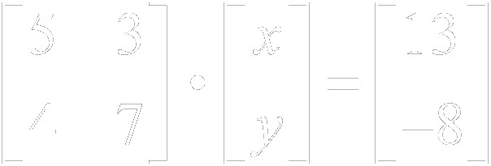
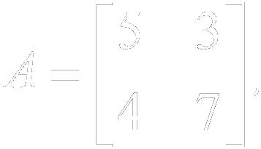
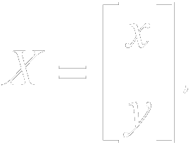
Example 8-3a
Use a matrix equation to solve the system of equations.
The matrix equation when

Slide 33
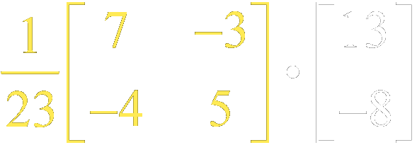
Example 8-3b
Step 1 Find the inverse of the coefficient matrix.
Step 2 Multiply each side of the matrix equation by the inverse matrix.
Multiply each side by A^{–1}.

Slide 34
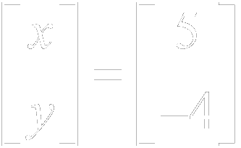
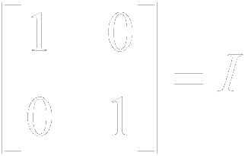
Example 8-3c
Multiply matrices.
Answer: The solution is (5, –4). Check this solution in the original equations.

Slide 35
Example 8-3d
Use a matrix equation to solve the system of equations.
Answer: (2, –4)

Slide 36
Example 8-4a
Use a matrix equation to solve the system of equations.
The matrix equation is when

Slide 37
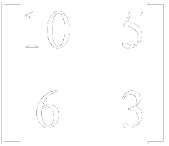
Example 8-4b
Find the inverse of the coefficient matrix.
The determinant of the coefficient matrix is 0, so A^{–1} does not exist.

Slide 38
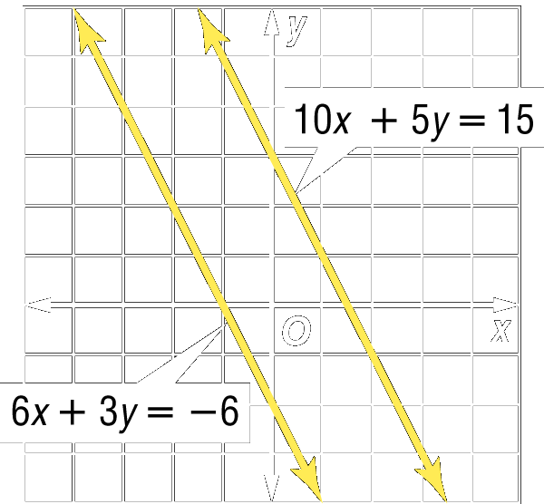
Example 8-4c
Graph the system of equations.
Since the lines are parallel, this system has no solution.
The system is inconsistent.
Answer: There is no solution of this system.

Slide 39
Example 8-4d
Use a matrix equation to solve the system of equations.
Answer: no solution

Slide 40
End of Lesson 8

