Slide 1
Notes for 3.1/3.2
For y = 3 + 7 cos 4(θ - 20°), identify the:
Vertical dilation
Vertical translation
Horizontal dilation
Horizontal translation
For the sinusoid above, identify the:
Amplitude
Period
Phase displacement (for cosine)
Sinusoidal axis location

Slide 2
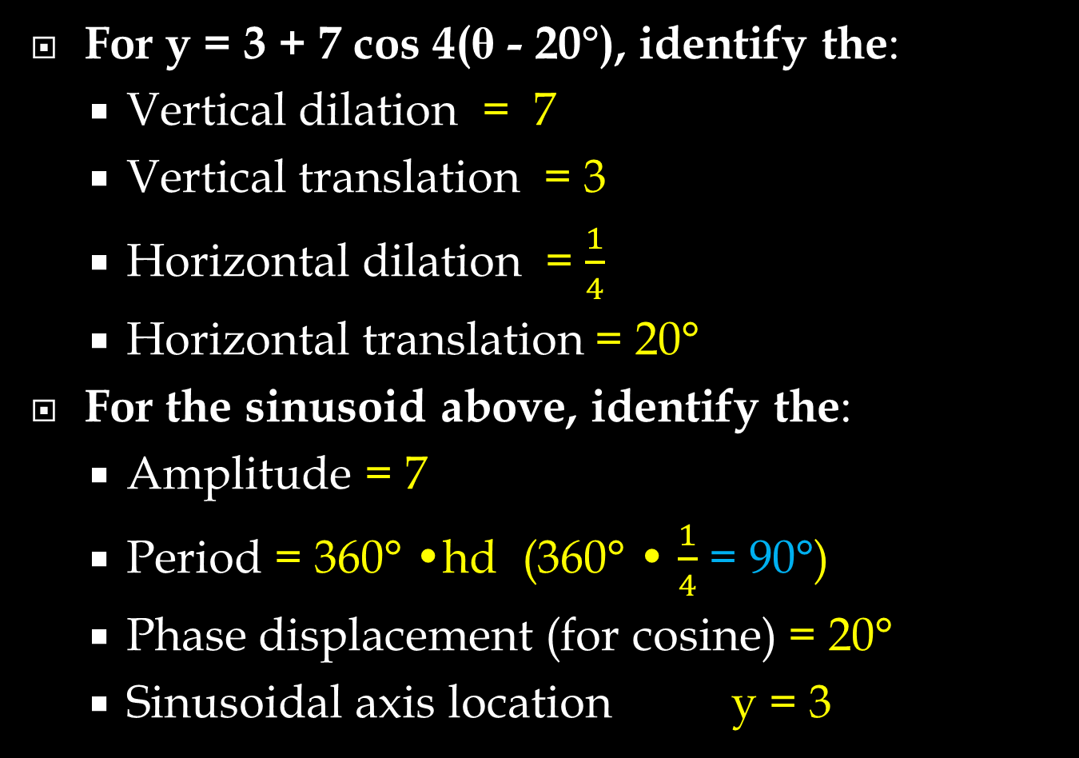
Notes for 3.1/3.2
For y = 3 + 7 cos 4(θ - 20°), identify the:
Vertical dilation = 7
Vertical translation = 3
Horizontal dilation = $\frac{1}{4}$
Horizontal translation = 20°
For the sinusoid above, identify the:
Amplitude = 7
Period = 360° •hd (360° • $\frac{1}{4}$ = 90°)
Phase displacement (for cosine) = 20°
Sinusoidal axis location y = 3

Slide 3
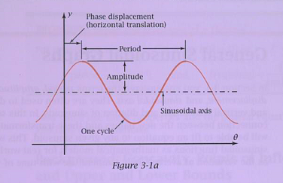
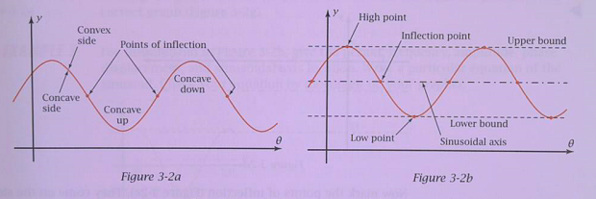
Important parts of graphs

Slide 4
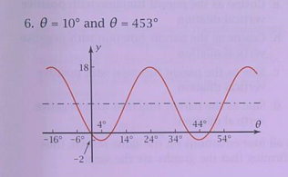
Write an equation for the sinusoid (use sine or cosine)
Give the amplitude , period , frequency, phase displacement , and sinusoidal axis location
Use the equation to calc. θ = 10° and θ = 453°

Slide 5

Write an equation for the sinusoid (use sine or cosine) y = 8 + 10 sin [9(θ - 14°)]
Give the amplitude (10), period (40°), frequency ($\frac{1}{40}$), phase displacement (14°), and sinusoidal axis location ( y = 8)
Use the equation to calc. θ = 10° (17.41) and θ = 453° (6.44)

