Slide 1
Warm – up after 3.1/3.2 Day 1
For y = -5 + 6 cos 2(θ + 90°), identify the:
Vertical dilation
Vertical translation
Horizontal dilation
Horizontal translation
For the sinusoid above, identify the:
Amplitude
Period
Phase displacement (for cosine)
Sinusoidal axis location

Slide 2
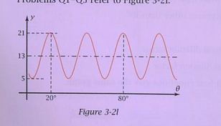
Warm- up (con’t)
How many cycles are
there b/w 20° and 80°?
What is the amplitude?
What is the period?
What is the vertical
translation?
What is the horizontal
translation (for cosine?)

Slide 3
Warm-up (p. 3)
Find the exact value (no decimals) of sin 60°
Find the approximate value of sec 71°
Find the approximate value of cot⁻¹ 4.3
Find the measure of the larger acute angle of a right triangle with legs 11ft. and 9 ft.
Expand: (3x – 5)²

